Slide 1
Chapter 18: Parallel Databases

Slide 2
Chapter 18: Parallel Databases
Introduction
I/O Parallelism
Interquery Parallelism
Intraquery Parallelism
Intraoperation Parallelism
Interoperation Parallelism
Design of Parallel Systems

Slide 3
Some || Terminology
Ideal
Xact/sec.
(throughput)
Speed-Up
  Adding more resources results in proportionally less running time for a fixed amount of data.
Scale-Up
  If resources are increased in proportion to an increase in data/problem size, the overall time should remain constant.
degree of ||-ism
Ideal
sec./Xact
(response time)
degree of ||-ism

Slide 4
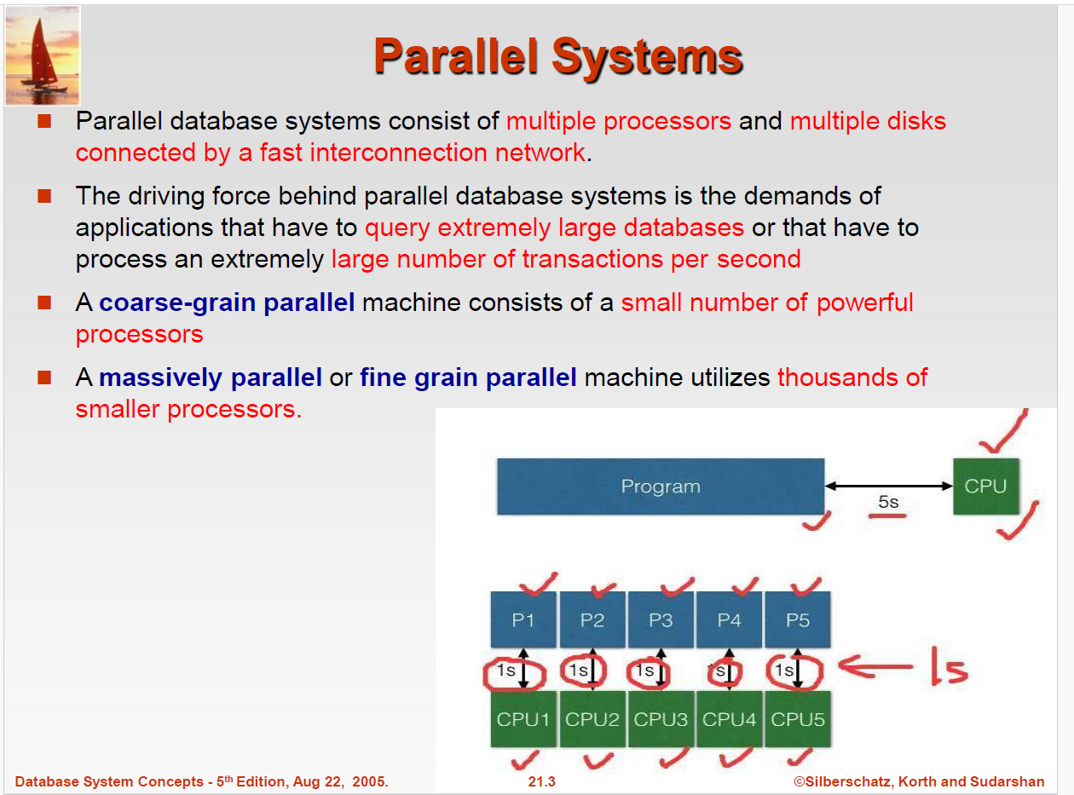


Slide 5
Parallel Systems
Two main performance measures:
throughput ---the number of tasks that can be completed in a given time interval
response time ---the amount of time it takes to complete a single task from the time it is submitted
Notes:
Multicore system
cores are usually integrated into single IC (integrated circuit) die, or onto multiple dies but in single chip package. Thus allowing higher Cache Coherency. With lesser traffic(cores integrated into single chip and will require less time for communication among themselves which is not case with multiple processor system as chips are different so IPC is heavy)
These systems are energy efficient since they allow higher performance at lower energy. A challenge in this, however, is additional overhead of writing parallel code.
Where as in parallel systems with multiple processors
Since more than one processor are working at the same time, throughput will get increased.
More reliable since failure in one CPU does not affect other.
It needs little complex configuration.
Parallel processing

Slide 6
Parallel Database Architectures
Shared memory --processors share a common memory
Shared disk --processors share a common disk
Shared nothing --processors share neither a common memory nor common disk
Hierarchical --hybrid of the above architectures

Slide 7
Architecture Issue: Shared What?
Shared Memory
(SMP)
Shared Disk
Shared Nothing
(network)
CLIENTS
CLIENTS
CLIENTS
Processors
Memory
Easy to program
Expensive to build
Difficult to scale
(Use affinity routing
to approximate SN-
like non-contention)
Hard to program
Cheap to build
Easy to scale
Notes:
101

Slide 8
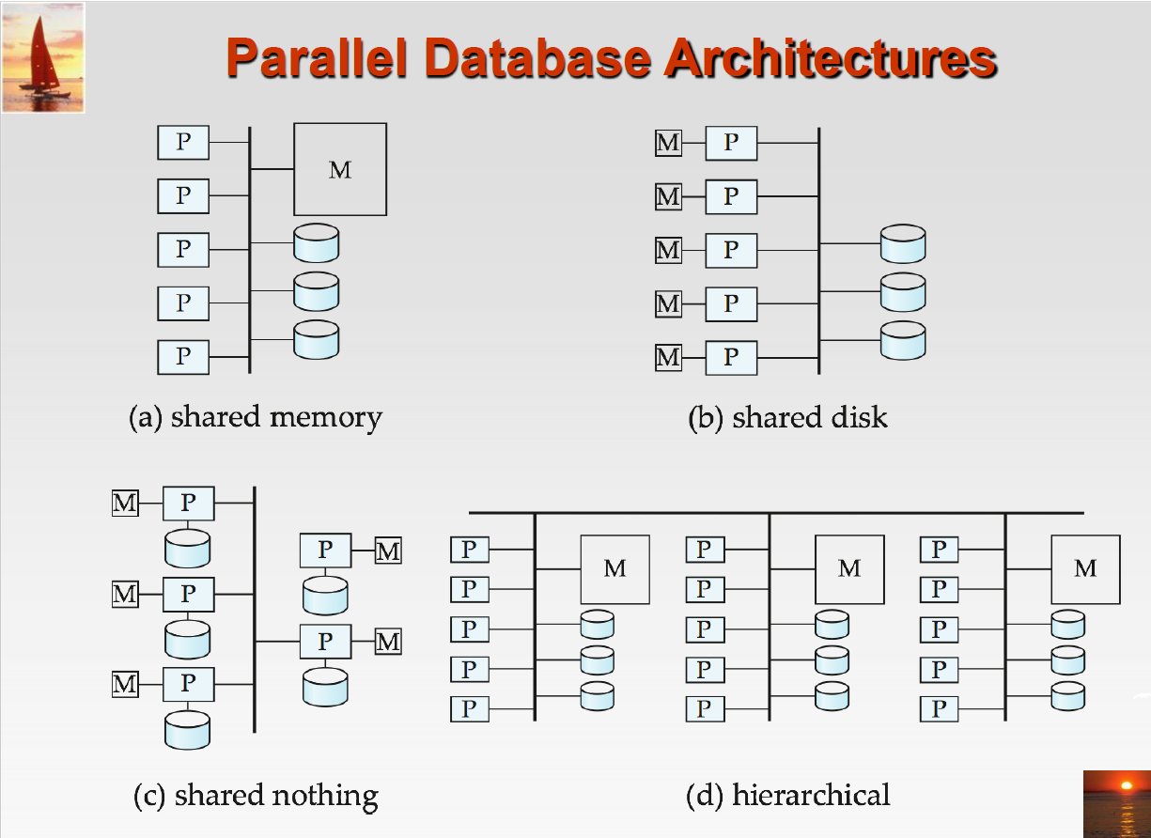

Slide 9
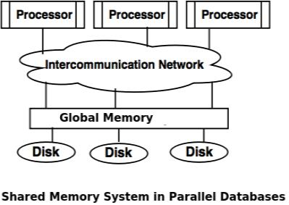
Architecture for parallel databases
Although data may be stored in a distributed fashion( in fragments), the distribution is governed solely by performance considerations. Parallel databases improve processing and input/output speeds by using multiple CPUs and disks in parallel. ... Shared memory architecture.

Slide 10
Why parallelism is needed in database?
Parallel machines are becoming quite common and affordable
  Prices of microprocessors, memory and disks have dropped sharply
  Recent desktop computers feature multiple processors and this trend is projected to accelerate
Databases are growing increasingly large
  large volumes of transaction data are collected and stored for later analysis.
  multimedia objects like images are increasingly stored in databases
Large-scale parallel database systems increasingly used for:
  storing large volumes of data
  processing time-consuming decision-support queries
  providing high throughput for transaction processing

Slide 11
Parallelism in Databases
Data can be partitioned across multiple disks for parallel I/O.
Individual relational operations (e.g., sort, join, aggregation) can be executed in parallel
  data can be partitioned and each processor can work independently on its own partition.
Queries are expressed in high level language (SQL, translated to relational algebra)
  makes parallelization easier.
Different queries can be run in parallel with each other. Concurrency control takes care of conflicts.
Thus, databases naturally lend themselves to parallelism.

Slide 12
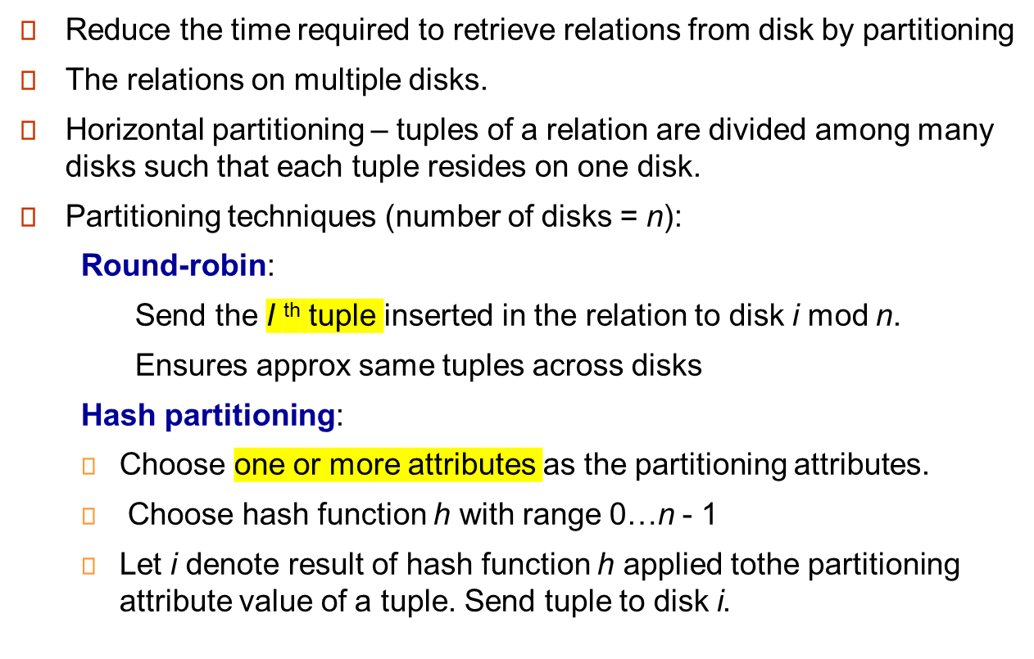
I/O Parallelism

Slide 13
I/O Parallelism (Cont.)
Partitioning techniques (cont.):
Range partitioning:
  Choose an attribute as the partitioning attribute.
  A partitioning vector [v_{o}, v₁, ..., v_{n-2}] is chosen.
  Let v be the partitioning attribute value of a tuple. Tuples such that v_{i} ≤ v_{i+1} go to disk i + 1.
  E.g., range partitioning with 3 disks numbered as 0, 1 and 2 may assign tuples with values less than 5 to disk 0, values between 5 and 40 to disk1 and values greater than 40 to disk 2.
  Example

Slide 14
Comparison of Partitioning Techniques
Evaluate how well partitioning techniques support the following types of data access:
1. Scanning the entire relation.
2. Locating a tuple associatively – point queries.
  E.g., r.A = 25.
3. Locating all tuples such that the value of a given attribute lies within a specified range – range queries.
  E.g., 10 ≤ r.A < 25.

Slide 15
Comparison of Partitioning Techniques (Cont.)
Round robin:
Advantages
  Best suited for sequential scan of entire relation on each query.
  All disks have almost an equal number of tuples; retrieval work is thus well balanced between disks.
Range queries are difficult to process
  No clustering -- tuples are scattered across all disks

Slide 16
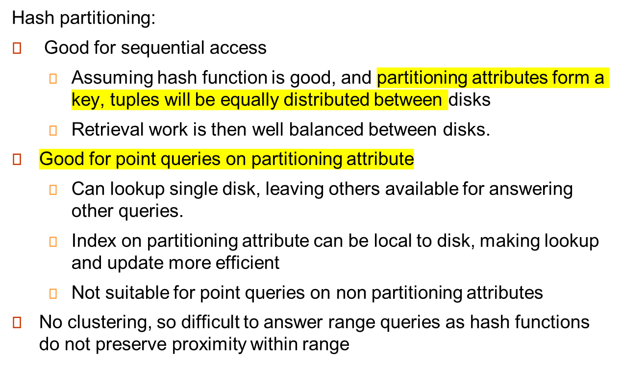
Comparison of Partitioning Techniques (Cont.)

Slide 17
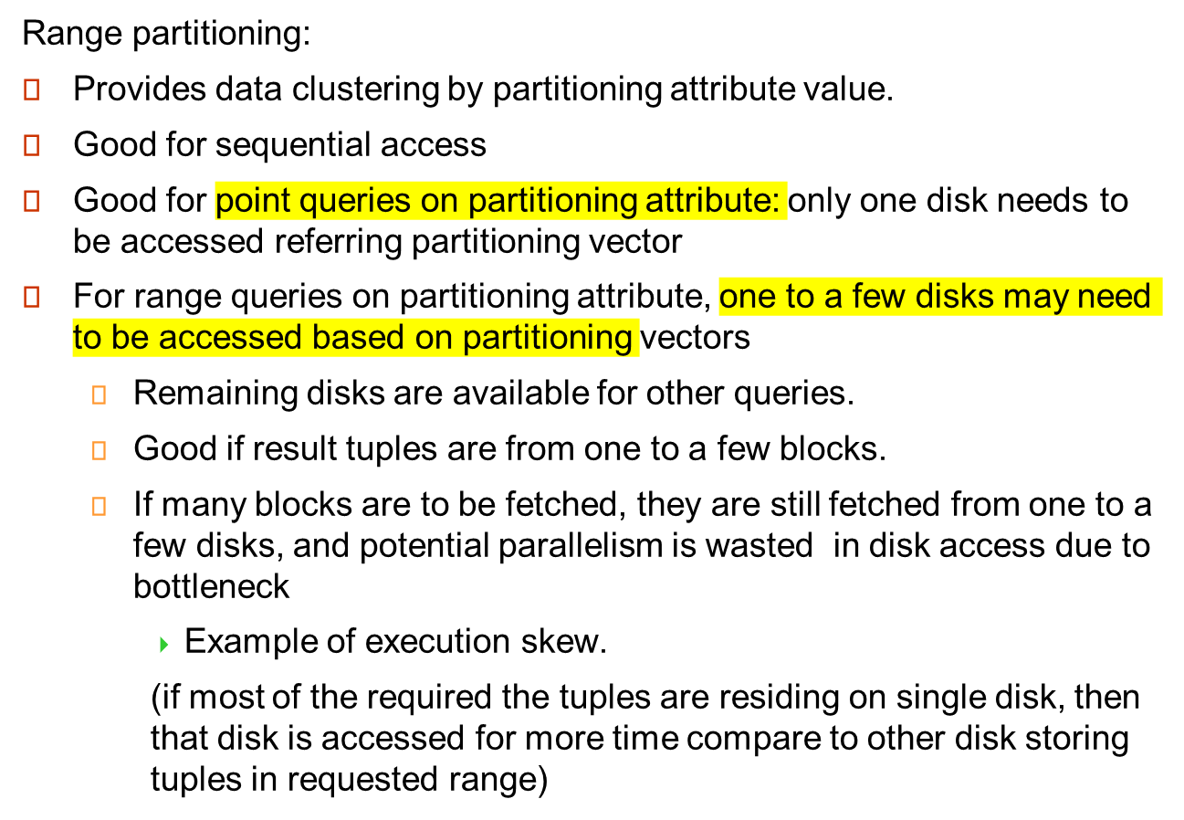
Comparison of Partitioning Techniques (Cont.)

Slide 18
Partitioning a Relation across Disks
If a relation contains only a few tuples which will fit into a single disk block, then assign the relation to a single disk.
Large relations are preferably partitioned across all the available disks.
If a relation consists of m disk blocks and there are n disks available in the system, then the relation should be allocated min(m,n) disks.

Slide 19
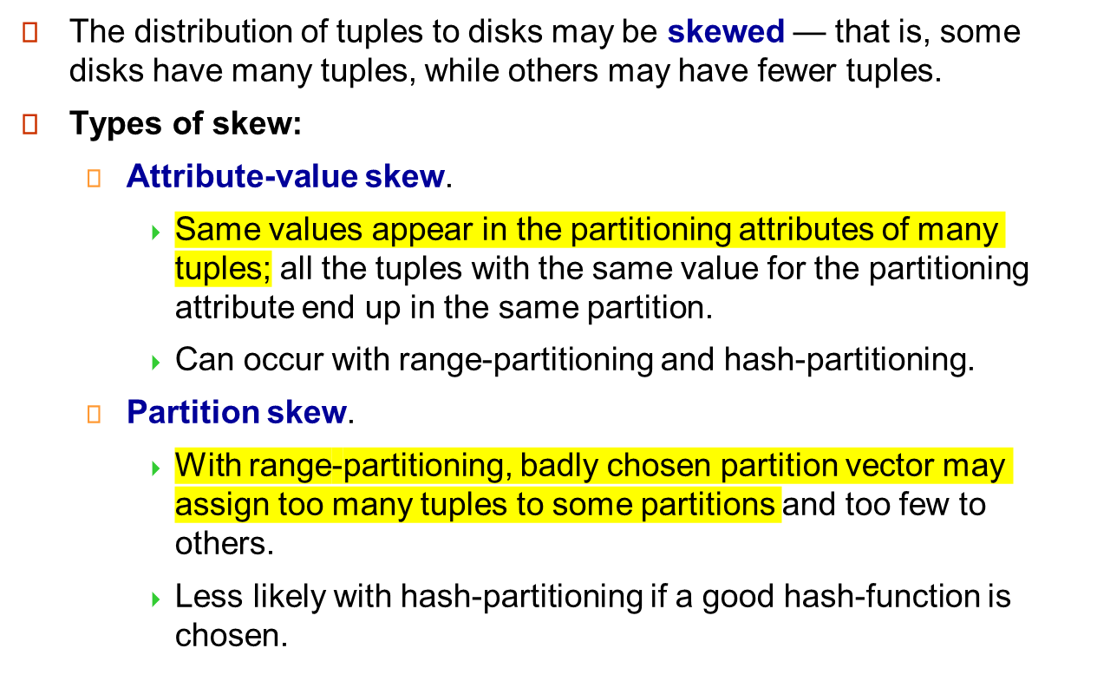
Handling of Skew

Slide 20
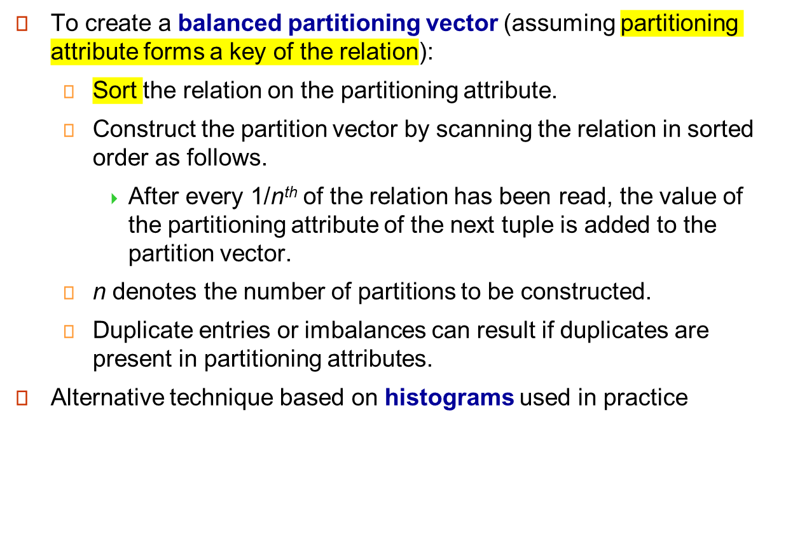
Handling Skew in Range-Partitioning

Slide 21
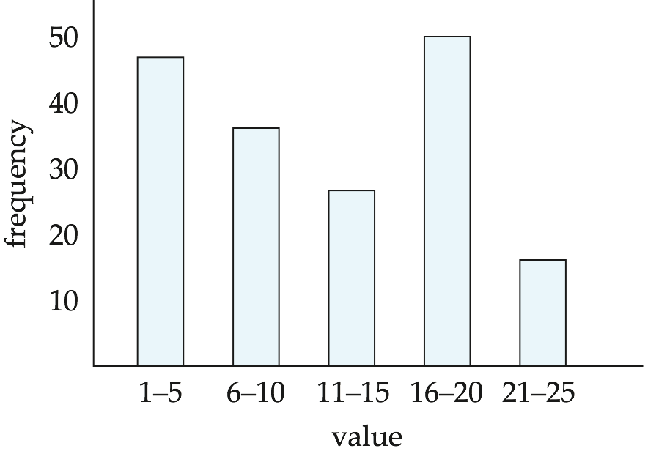
Handling Skew using Histograms
Balanced partitioning vector can be constructed from histogram in a relatively straightforward fashion
  Assume uniform distribution within each range of the histogram
Histogram can be constructed by scanning relation, or sampling (blocks containing) tuples of the relation

Slide 22
Handling Skew Using Virtual Processor Partitioning
Skew in range partitioning can be handled elegantly using virtual processor partitioning:
  create a large number of partitions (say 10 to 20 times the number of processors)
  Instead of real processors virtual processors are mapped to partitions
  And virtual processors are mapped to real processors usually in round-robin fashion
  Basic idea:
  if some range has more tuples than other because of skew then these tuples would get split across multiple virtual processors range.
  And due to round-robin allocation of processors only one processor will not bear all the burden.

Slide 23
Interquery Parallelism
Queries/transactions execute in parallel with one another.
Increases transaction throughput; used primarily to scale up a transaction processing system to support a larger number of transactions per second.
Easiest form of parallelism to support, particularly in a shared-memory parallel database, because even sequential database systems support concurrent processing.
More complicated to implement on shared-disk or shared-nothing architectures
  Locking and logging must be coordinated by passing messages between processors.
  Data in a local buffer may have been updated at another processor.
  Cache-coherency has to be maintained — reads and writes of data in buffer must find latest version of data.
Notes:
Submit batch of transactions and execute each of them in parallel.

Slide 24
Cache Coherency Protocol
Example of a cache coherency protocol for shared disk systems:
  Before reading/writing to a page, the page must be locked in shared/exclusive mode.
  On locking a page, the page must be read from disk
  Before unlocking a page, the page must be written to disk if it was modified.
More complex protocols with fewer disk reads/writes exist.
Cache coherency protocols for shared-nothing systems are similar. Each database page is assigned a home processor. Requests to fetch the page or write it to disk are sent to the home processor.

Slide 25
Intraquery Parallelism
Execution of a single query in parallel on multiple processors/disks; important for speeding up long-running queries.
Two complementary forms of intraquery parallelism:
  Intraoperation Parallelism – parallelize the execution of each individual operation in the query.
  Interoperation Parallelism – execute the different operations in a query expression in parallel.
the first form scales better with increasing parallelism because
the number of tuples processed by each operation is typically more than the number of operations in a query.

Slide 26
Parallel Processing of Relational Operations
Our discussion of parallel algorithms assumes:
  read-only queries(so no read write conflit)
  shared-nothing architecture
  n processors, P₀, ..., P_{n-1}, and n disks D₀, ..., D_{n-1}, where disk D_{i} is associated with processor P_{i}.
If a processor has multiple disks they can simply simulate a single disk D_{i}.
Shared-nothing architectures can be efficiently simulated on shared-memory and shared-disk systems.
  Algorithms for shared-nothing systems can thus be run on shared-memory and shared-disk systems.
  However, some optimizations may be possible.
Notes:
Disk and memory in share memory can be partitioned and assigned to individual processor to simulate share nothing

Slide 27
Parallel Sort
Range-Partitioning Sort
Choose processors P₀, ..., P_{m}, where m ≤ n -1 to do sorting.
Create range-partition vector with m entries, on the sorting attributes
Redistribute the relation using range partitioning
  all tuples that lie in the i^{th} range are sent to processor P_{i}
  P_{i} stores the tuples it received temporarily on disk D_{i}.
  This step requires I/O and communication overhead.
Each processor P_{i} sorts its partition of the relation locally.
Each processors executes same operation (sort) in parallel with other processors, without any interaction with the others (data parallelism).
Final merge operation is trivial: range-partitioning ensures that,for i, j m, the key values in processor P^{i} are all less than the key values in P_{j}.
Notes:
Initial partitioning may not be compatible to sort
So we need to formulate partitioning vector
And then may have to read the typles in particular partition for particular processor from multiple processors related disks
This is overhead of communication and IO within disks

Slide 28
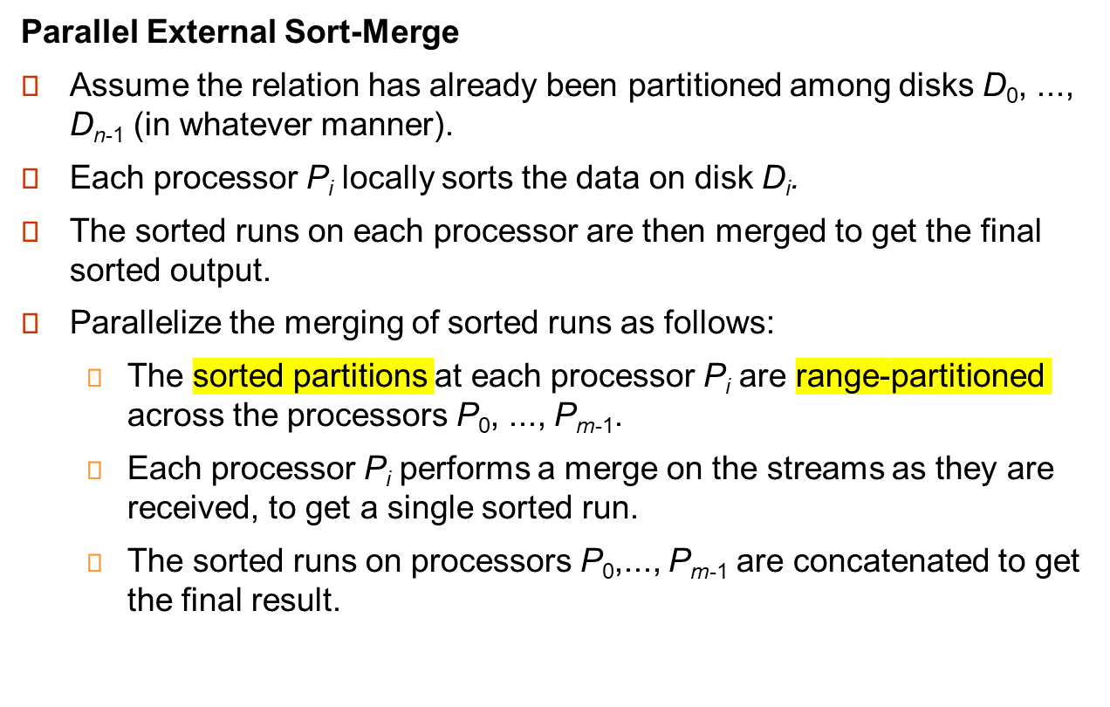
Parallel Sort (Cont.)
Notes:
Sorting as per stored partitions locally(may not be in order)
Then range partitioning these. So each processor may respond with slice of relation in that range.
As per partition vector these ranges are assigned to processors
Then each processor will merge these slices as and when received.
Finally collect merged data of each processor to get final sorted relation

Slide 29
Parallel Join
The join operation requires pairs of tuples to be tested to see if they satisfy the join condition, and if they do, the pair is added to the join output.
Parallel join algorithms attempt to split the pairs to be tested over several processors. Each processor then computes part of the join locally.
In a final step, the results from each processor can be collected together to produce the final result.

Slide 30
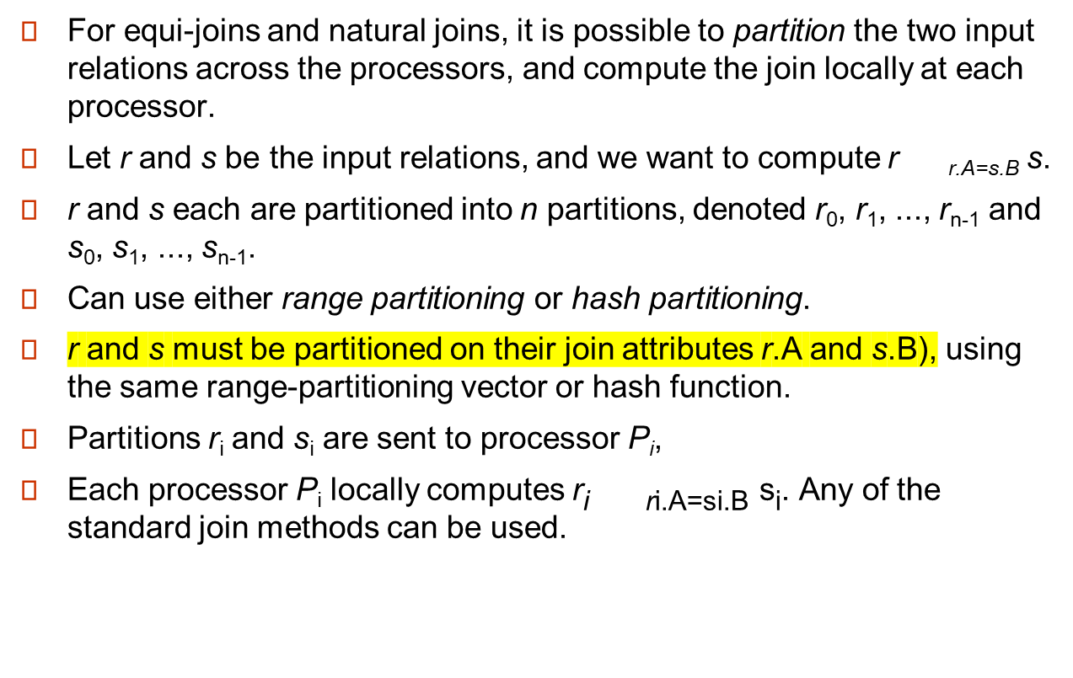
Partitioned Join

Slide 31
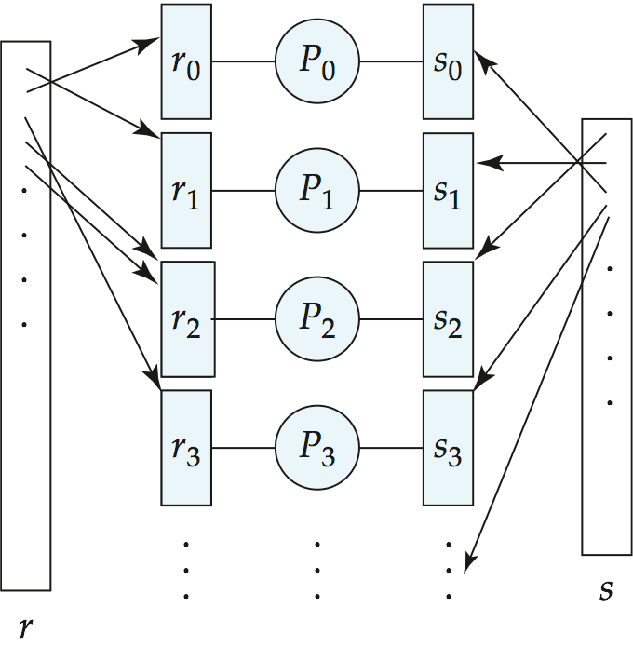
Partitioned Join (Cont.)

Slide 32
Fragment-and-Replicate Join
Partitioning not possible for some join conditions
  E.g., non-equijoin conditions, such as r.A > s.B.
For joins where partitioning is not applicable, parallelization can be accomplished by fragment and replicate technique
  It is possible that all tuples in relation r will join with some tuples in relation s
Special case – asymmetric fragment-and-replicate:
  One of the relations, say r, is partitioned; any partitioning technique can be used.
  The other relation, s(build relation) is replicated across all the processors.
  Processor P_{i} then locally computes the join of r_{i} with all of s using any join technique.

Slide 33
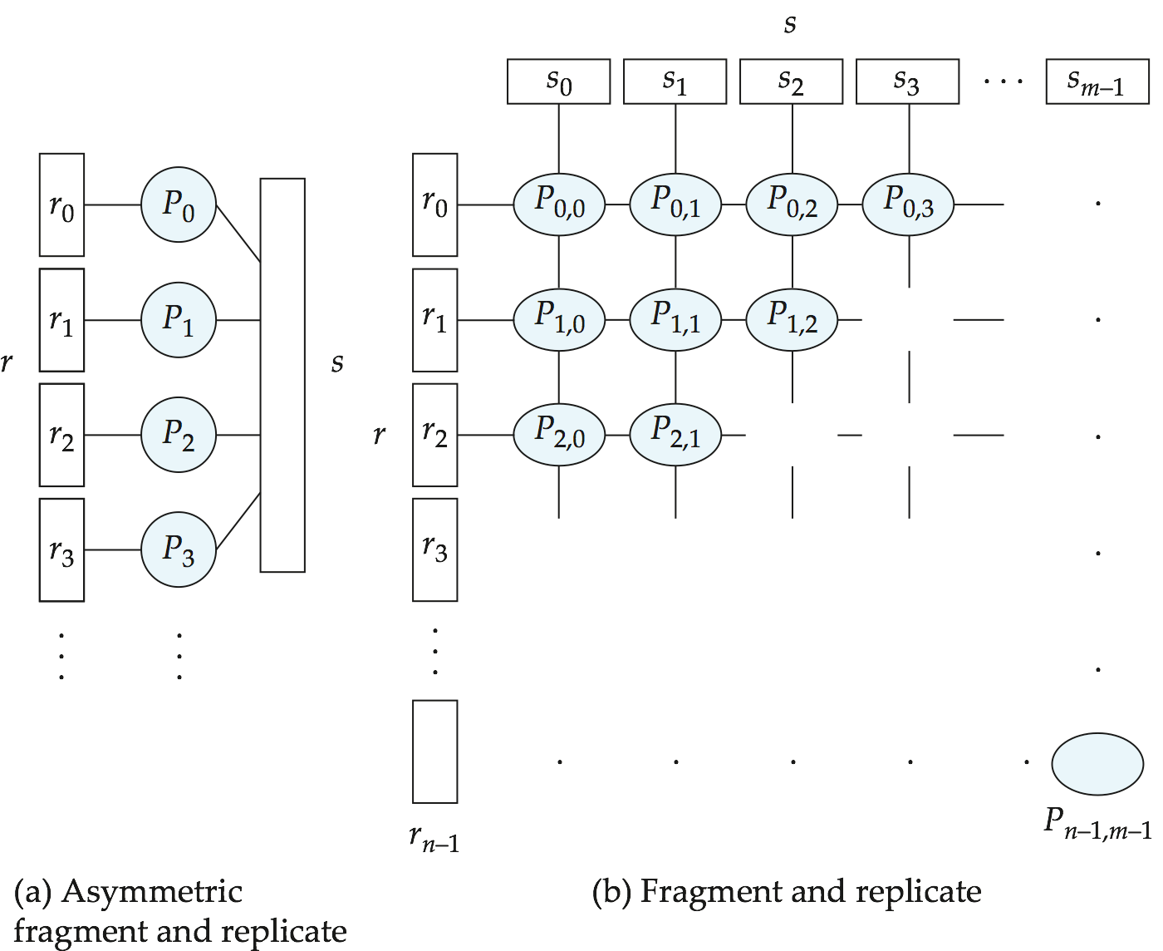
Depiction of Fragment-and-Replicate Joins
r.age<=s.age
Age 25-35
Age 36-45
Age4646-55
Age4656-65
Age 25-35

Slide 34
Fragment-and-Replicate Join (Cont.)
General case: reduces the sizes of the relations at each processor.
  r is partitioned into n partitions,r₀, r₁, ..., r _{n-1};s is partitioned into m partitions, s₀, s₁, ..., s_{m-1}.
  Any partitioning technique may be used.
  There must be at least m * n processors.
  Label the processors as
  P_{0,0}, P_{0,1}, ..., P_{0,m-1}, P_{1,0}, ..., P_{n-1m-1}.
  P_{i,j} computes the join of r_{i} with s_{j}. In order to do so, r_{i} is replicated to P_{i,0}, P_{i,1}, ..., P_{i,m-1}, while s_{i} is replicated to P_{0,i}, P_{1,i}, ..., P_{n-1,i}
  Any join technique can be used at each processor P_{i,j}.

Slide 35
Fragment-and-Replicate Join (Cont.)
Both versions of fragment-and-replicate work with any join condition, since every tuple in r can be tested with every tuple in s.
Usually has a higher cost than partitioning, since one of the relations (for asymmetric fragment-and-replicate) or both relations (for general fragment-and-replicate) have to be replicated.
Sometimes asymmetric fragment-and-replicate is preferable even though partitioning could be used.
  E.g., say s is small and r is large, and already partitioned. It may be cheaper to replicate s across all processors, rather than repartition r and s on the join attributes.

Slide 36
Partitioned Parallel Hash-Join
Parallelizing partitioned hash join:
Assume s is smaller than r and therefore s is chosen as the build relation.
A hash function h₁ takes the join attribute value of each tuple in s and maps this tuple to one of the n processors.
Each processor P_{i} reads the tuples of s that are on its disk D_{i}, and sends each tuple to the appropriate processor based on hash function h₁. Let s_{i} denote the tuples of relation s that are sent to processor P_{i}.
As tuples of relation s are received at the destination processors, they are partitioned further using another hash function, h₂, which is used to compute the hash-join locally. (Cont.)

Slide 37
Partitioned Parallel Hash-Join (Cont.)
Once the tuples of s have been distributed, the larger relation r is redistributed across the m processors using the hash function h₁
  Let r_{i} denote the tuples of relation r that are sent to processor P_{i}.
As the r tuples are received at the destination processors, they are repartitioned using the function h₂
Each processor P_{i} executes the build and probe phases of the hash-join algorithm on the local partitions r_{i} and si of r and s to produce a partition of the final result of the hash-join.
Note: Hash-join optimizations can be applied to the parallel case
  e.g., the hybrid hash-join algorithm can be used to cache some of the incoming tuples in memory and avoid the cost of writing them and reading them back in.
Notes:
hash tuple’s join key of R and probe into hash table built from s
where S is build relation and R is probe relation
Build relation is used to build hash table

Slide 38
Parallel Nested-Loop Join
Assume that
  relation s is much smaller than relation r and that r is stored by partitioning.
  there is an index on a join attribute of relation r at each of the partitions of relation r.
Use asymmetric fragment-and-replicate, with relation s being replicated, and using the existing partitioning of relation r.
Each processor P_{j} where a partition of relation s is stored reads the tuples of relation s stored in D_{j}, and replicates the tuples to every other processor P_{i}.
  At the end of this phase, relation s is replicated at all sites that store tuples of relation r.
Each processor P_{i} performs an indexed nested-loop join of relation s with the i^{th} partition of relation r.

